Slide 1

Population Demographics vs. LTE Cellular Data
10-02-2019
The Four Horseman
Anthony
David
Bryan
Praveen

Slide 2

OUTLINE
Hypothesis
Questions
Data Sources
Data Cleanup and Exploration
Data Analysis

Slide 3
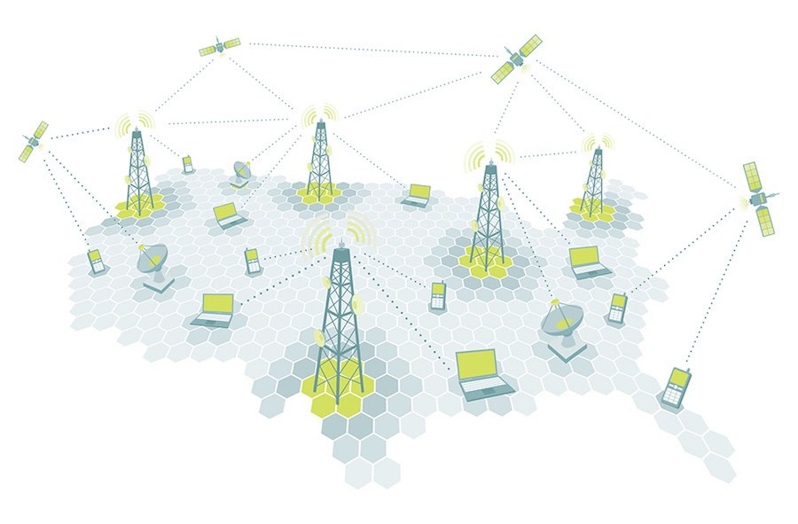
HYPOTHESIS
QUESTIONS
Population size influences the number of LTE cell towers.
Does the population size influence the number of LTE cell towers in a geographical location?
Does the median income influence the number of LTE cell tower in a geographical location?
Do counts of towers represent an increase in cell signal?
Are there other components on a cell tower that increase cell signal and do not require additional towers to be built?
What carrier has the best cellular coverage?

Slide 4
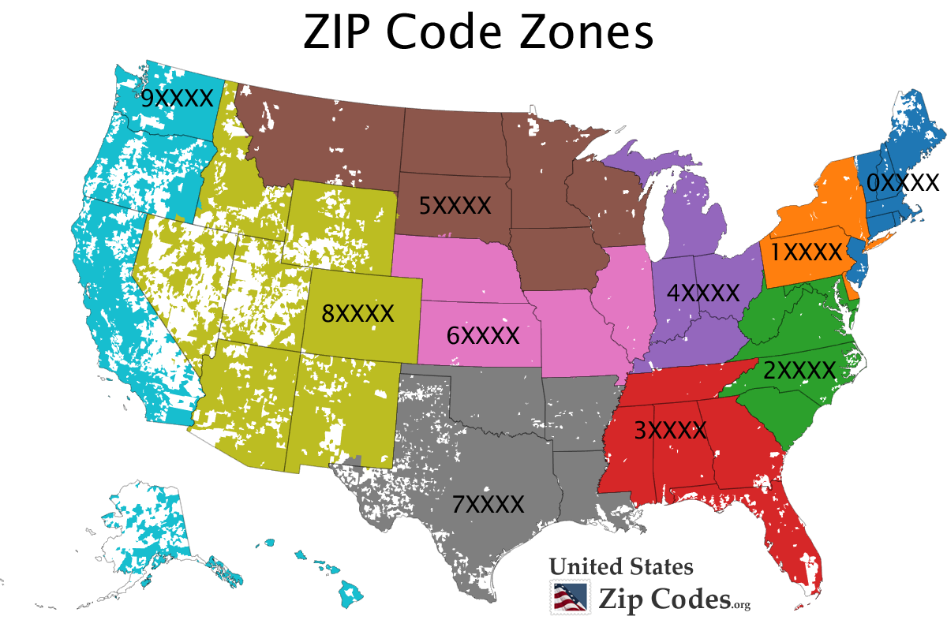
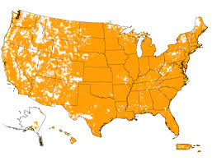

DATA
We sourced 3 main pieces of data:
Census data was pulled from the census api to capture the median income and population size based on zip code.
A zip code csv was sourced from https://simplemaps.com/data/us-zips to add City and State to the Census data.
Cell tower csv was sourced from https://www.opencellid.org
Data was sourced from multiple endpoints. The easiest data to capture was the census data and we trusted the accuracy. To expand on the census data we searched the internet for a zip code csv which we secured. On the other hand the cell tower data was much more difficult to come by. We first explored APIs to identify if there was a free API we could utilize. However, we were not able to locate a free service thru an API. We then turned to searching the internet for a csv file. After, posting on a forum someone directed us to opencellid.org which had a csv file.

Slide 5
DATA CLEANUP & EXPLORATION
Census Data
The census data was relatively straight forward. The only cleanup we performed was dropping median income less than zero.
We did add city and state to the census data to later merge with the cell tower data.
Zip Code
This file was straight forward. It contained the necessary data and did not provide any issues.
Cell Tower Data
The first thing we noticed was how large the csv file was. We found that the file contained information for multiple countries. We set up parameters to only source the United States.
We also found that the records were not based on cell towers but something much more granular. Through researching the different data points we believe the records are by aggregate of cellular emissions and the metrics are analyzing the collected signal for that day.
Another issue we ran into was merging zip code data on the area field. The area field is the zip code field in the cell data but doesn’t have a consistent format. In some instances it had more than 5 characters and in others it had less.
Merging the cell tower data and the census data proved to be difficult. We used zip code as the merge however the cell tower data had far fewer records. The cell tower data had 7,630 records while the census data had 33,120. Once the tables were merged the join only produced 2,422 viable records.
Even after cleaning and exploring the data we recognize that the cell tower data is not reliable.
Insights from the data exploration process
The cell tower data is not a good source.

Slide 6
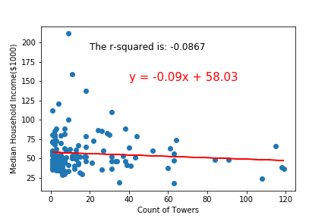
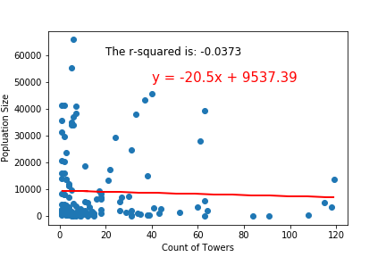
DATA ANALYSIS
The model explains none of the variability of the response data around its mean.
Although the model indicates no relationship, upon researching the topic we know that the coverage areas are much greater around cities with higher populations. This could indicate that its not necessarily the count of towers but how much signal each tower is able to produce that has a better relationship with population.
This could also indicate that there is no integrity in the data or the way the data is derived.

Slide 7
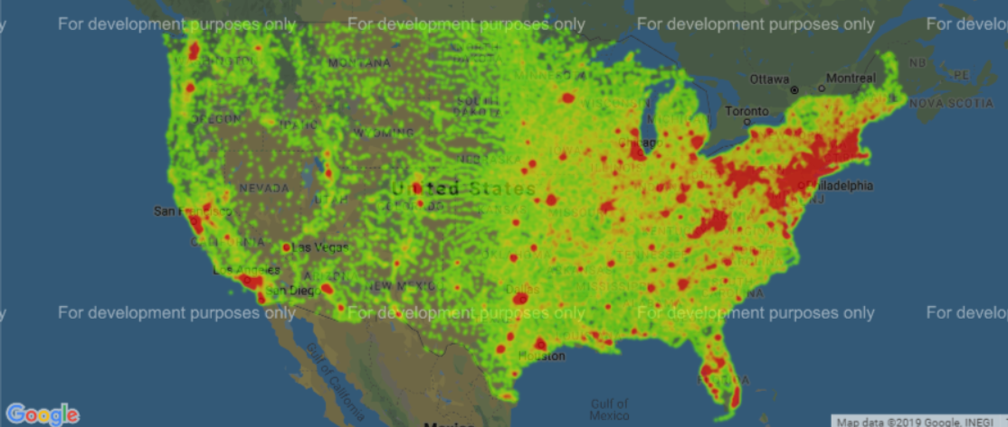
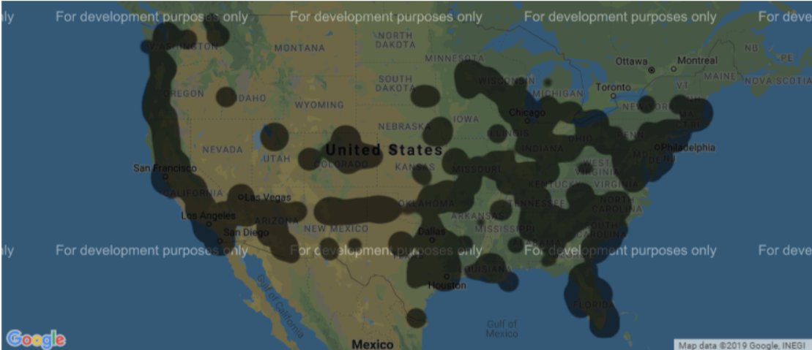
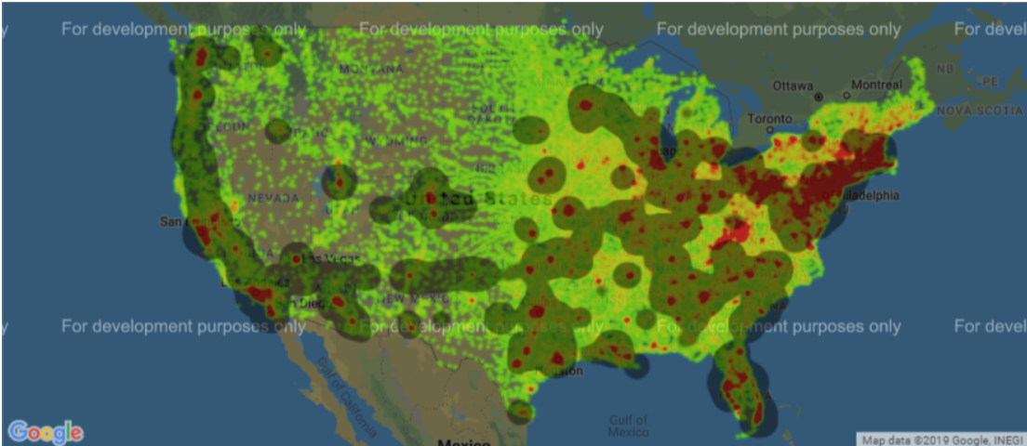
Population and LTE cell data correlation
Population
LTE Cell Data
Merge

Slide 8
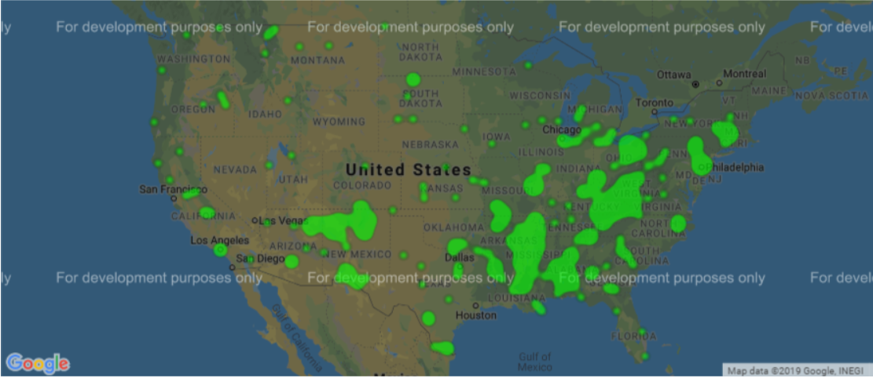
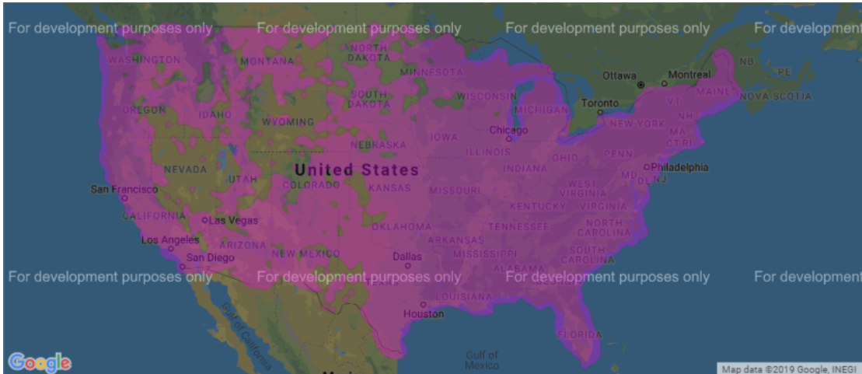
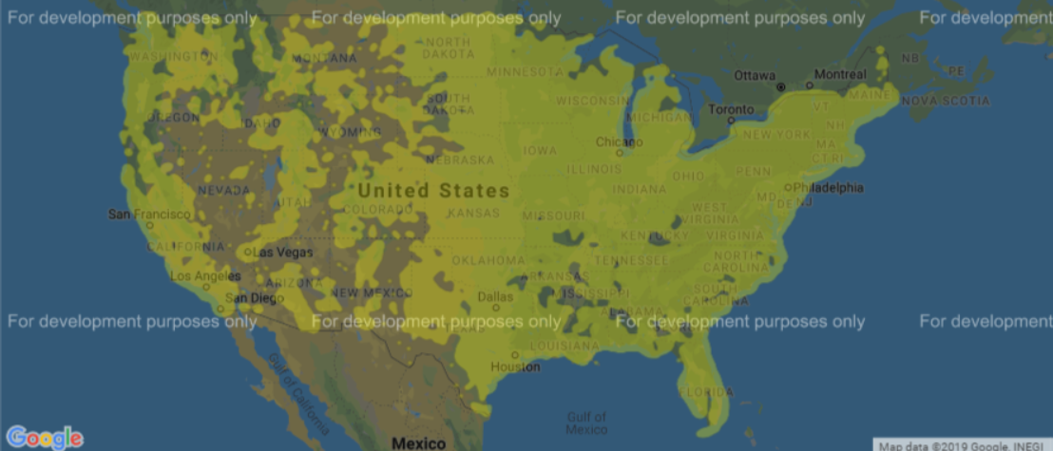
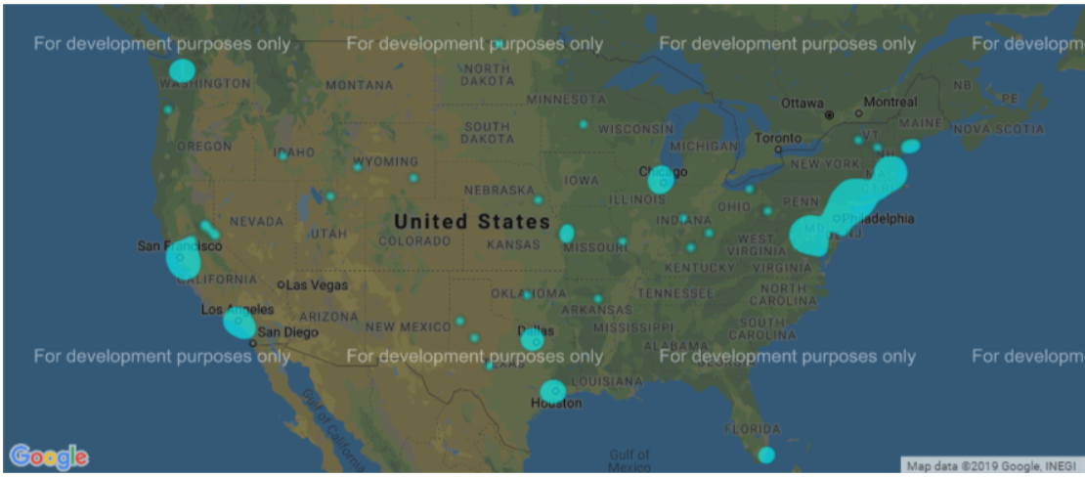
Income
Lower
Middle
Upper Middle
Upper

Slide 9
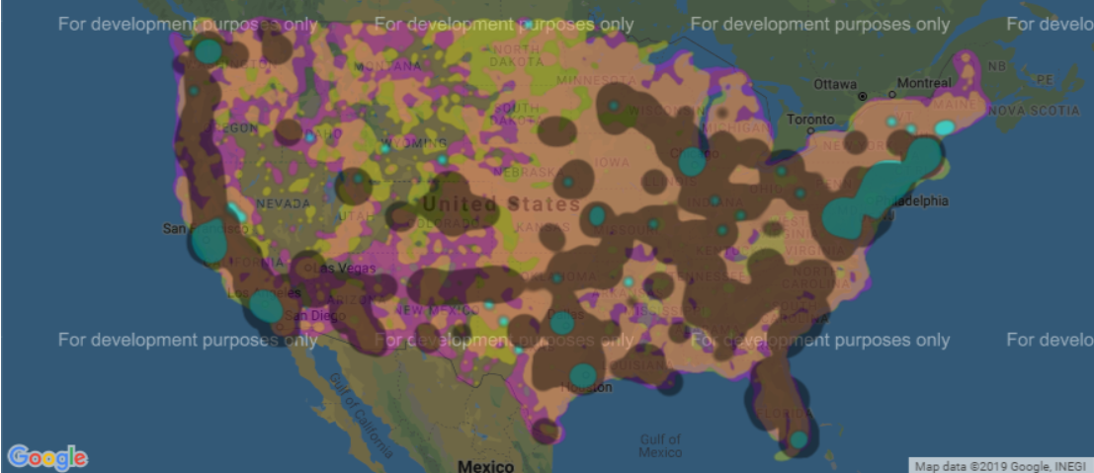
Income & LTE Signal Combined

Slide 10
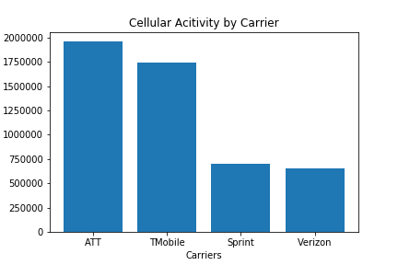
"The data set from OpenCellID we used is from various collections of cellular data from multiple sources. They update their data each day with a new aggregate of cellular emissions. This is a chart showing how many collected cellular data points were collected in total from each carrier for each day of collection.“

Slide 11
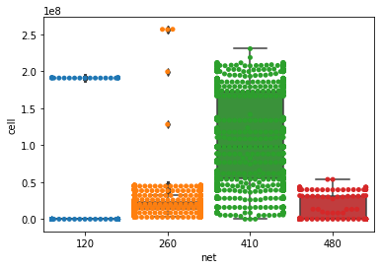
Distribution of Cell Towers by Network Carrier

Slide 12
DISCUSSION
Discuss your findings. Did you find what you expected to find? If not, why not? What inferences or general conclusions can you draw from your analysis?
FUTURE DIRECTION
Post Mortem
Discuss any difficulties that arose, and how you dealt with them
Discuss any additional questions that came up, but which you didn't have time to answer: What would you research next, if you had two more weeks?

Slide 13
SUMMARY
Describe whether you were able to answer these questions to your satisfaction, and briefly summarize your findings
Questions

